Slide 1


TITLE
Deep Dive on "HEALTH DATA ANALYSIS"
Presented by
BULTY DOLUI
On
October 4th, 2024
ThePhoto by PhotoAuthor is licensed under CCYYSA.

Slide 2
INTRODUCTION
Objective: To perform a deep dive analysis of health data focusing on various health metrics and their correlations.

Slide 3
Dataset Columns:
AGE
SEX
BMI
BP
S1, S2, S3, S4, S5, S6
Y (Target Variable/Output)

Slide 4

Data Preparation import pandas as pd
import numpy as np
import seaborn as sns
import matplotlib.pyplot as plt
pandas: Used for data manipulation and analysis.
numpy: Provides support for arrays and numerical operations.
Scipy.stats: Contains statistical functions, including those for calculating Z-scores.

Slide 5

Import Libraries from io import StringIO
from io import StringIO: Imports StringIO, a method that allows you to treat a string as a file. This is useful for reading string data as if it were coming from a file.

Slide 6
#LOAD THE DATASET data = """
AGE SEX BMI BP S1 S2 S3 S4 S5 S6 Y
59 2 32.1 101 157 93.2 38 4 4.8598 87 151
48 1 21.6 87 183 103.2 70 3 3.8918 69 75
72 2 30.5 93 156 93.6 41 4 4.6728 85 141
24 1 25.3 84 198 131.4 40 5 4.8903 89 206
50 1 23 101 192 125.4 52 4 4.2905 80 135
23 1 22.6 89 139 64.8 61 2 4.1897 68 97
36 2 22 90 160 99.6 50 3 3.9512 82 138
66 2 26.2 114 255 185 56 4.55 4.2485 92 63
60 2 32.1 83 179 119.4 42 4 4.4773 94 110
29 1 30 85 180 93.4 43 4 5.3845 88 310
22 1 18.6 97 114 57.6 46 2 3.9512 83 101
56 2 28 85 184 144.8 32 6 3.5835 77 69
53 1 23.7 92 186 109.2 62 3 4.3041 81 179
50 2 26.2 97 186 105.4 49 4 5.0626 88 185
61 1 24 91 202 115.4 72 3 4.2905 73 118
34 2 24.7 118 254 184.2 39 7 5.037 81 171
47 1 30.3 109 207 100.2 70 3 5.2149 98 166
68 2 27.5 111 214 147 39 5 4.9416 91 144
38 1 25.4 84 162 103 42 4 4.4427 87 97
41 1 24.7 83 187 108.2 60 3 4.5433 78 168
35 1 21.1 82 156 87.8 50 3 4.5109 95 68
25 2 24.3 95 162 98.6 54 3 3.8501 87 49
25 1 26 92 187 120.4 56 3 3.9703 88 68

Slide 7
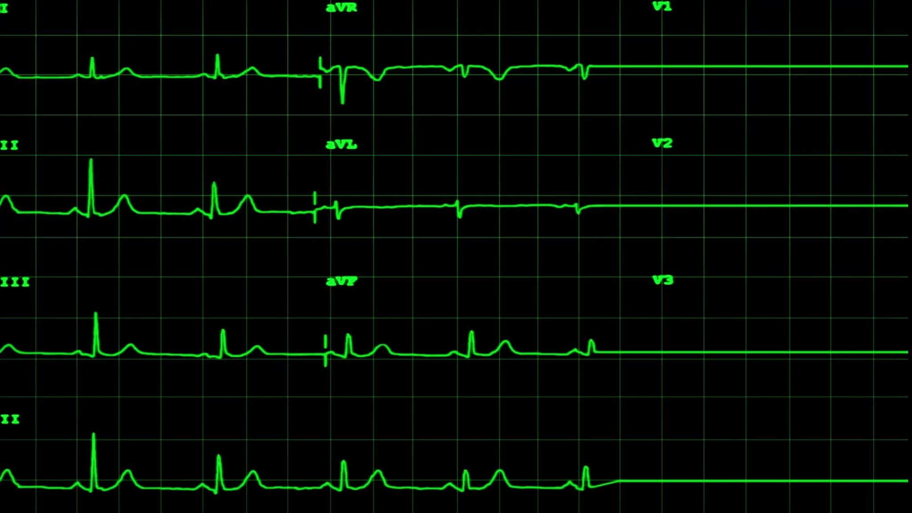
Creating a DataFrame: df = pd.read_csv(StringIO(data), sep="\t") pd.read_csv():
This is a pandas function used to read a comma-separated values (CSV) file into a DataFrame. While it is primarily designed for CSV files, it can also handle other delimiters.
StringIO(data):
StringIO is a module from the io package in Python that allows you to treat a string as a file-like object. This is useful when you have data in string format that you want to process as if it were read from a file.
data should be a string containing tabular data (in this case, separated by tabs).
sep="\t":
This parameter specifies the delimiter that separates the values in the data. The "\t" indicates that the values are separated by tabs (i.e., it’s a tab-delimited file).
ThePhoto by PhotoAuthor is licensed under CCYYSA.

Slide 8

Checking for Missing Values: missing_values = df.isnull().sum()
print("Missing Values:\n", missing_values)
df.isnull() generates a DataFrame of the same shape as df but with Boolean values (True for NaN).
.sum() adds up the True values for each column, giving the count of missing values in each column.

Slide 9
Finding Outliers: from scipy import stats
z_scores = np.abs(stats.zscore(df.select_dtypes(include=[np.number])))
outliers = (z_scores > 3).sum(axis=1)
from scipy import stats: Imports the stats module from the SciPy library, which contains functions for statistical calculations.
df.select_dtypes(include=[np.number]): Selects only the numerical columns from the DataFrame df.
z_scores = np.abs(stats.zscore(...)): Calculates the z-scores for the numerical columns. A z-score indicates how many standard deviations a data point is from the mean. The np.abs function takes the absolute value of the z-scores.
outliers = (z_scores > 3).any(axis=0): Checks if any z-scores in each column are greater than 3 (common threshold for outliers) and returns a boolean array indicating which columns contain outliers.

Slide 10
Interquartile Range (IQR) Method for Outlier Detection Q1 = df.quantile(0.25) Q3 = df.quantile(0.75) IQR = Q3 - Q1 outliers = ((df < (Q1 - 1.5 * IQR)) | (df > (Q3 + 1.5 * IQR)))
Q1 = df.quantile(0.25): Calculates the first quartile (25th percentile) of each column in the DataFrame.
Q3 = df.quantile(0.75): Calculates the third quartile (75th percentile) of each column.
IQR = Q3 - Q1: Computes the Interquartile Range (IQR), which measures the spread of the middle 50% of the data.
outliers = ((df < (Q1 - 1.5 * IQR)) | (df > (Q3 + 1.5 * IQR))): Identifies outliers based on the IQR method. Any value below Q1−1.5×IQRQ1 - 1.5 \times IQRQ1−1.5×IQR or above Q3+1.5×IQRQ3 + 1.5 \times IQRQ3+1.5×IQR is considered an outlier.

Slide 11
Print Outlier Information print(f"Number of outliers: {np.sum(outliers)}") print("Outliers detected in each column:\n", outliers)
print(f"Number of outliers: {np.sum(outliers)}"): Counts and prints the total number of outliers detected in the DataFrame.
print("Outliers detected in each column:\n", outliers): Prints a DataFrame (boolean) indicating which values are outliers in each column.

Slide 12
Transform Data Types
df = df.apply(pd.to_numeric, errors='coerce') print("Data types after transformation:\n", df.dtypes) data_types = df.dtypes print("Data Types:\n", data_types)
df = df.apply(pd.to_numeric, errors='coerce'): Converts all columns to numeric types. If a value cannot be converted, it is replaced with NaN due to errors='coerce'.
print("Data types after transformation:\n", df.dtypes): Prints the data types of each column after the transformation.
data_types = df.dtypes: Stores the data types in a variable for further use.
print("Data Types:\n", data_types): Prints the data types again, showing their current state.

Slide 13

Exploratory Data Analysis (EDA)

Slide 14
Calculating Correlation Matrix: correlation_matrix = df.corr()
df.corr() computes the pairwise correlation between columns in the DataFrame, returning a new DataFrame showing the correlation coefficients.
Visualizing the Correlation Matrix: plt.figure(figsize=(12, 8))
sns.heatmap(correlation_matrix, annot=True, fmt=".2f", cmap='magma')
plt.title("Correlation Matrix")
plt.show() plt.figure(figsize=(12, 8)) sets the size of the figure for the plot.
sns.heatmap(...) creates a heatmap from the correlation matrix, with annotations showing the correlation values formatted to two decimal places (fmt='.2f').
plt.title(...) adds a title to the plot.
plt.show() displays the plot.

Slide 15

Linear Regression Model Training
from sklearn.linear_model import LinearRegression from sklearn.model_selection import train_test_split X = df.drop('Y', axis=1) y = df['Y'] X_train, X_test, y_train, y_test = train_test_split(X, y, test_size=0.2, random_state=42)
from sklearn.linear_model import LinearRegression: Imports the LinearRegression class from Scikit-learn, used to create linear regression models.
from sklearn.model_selection import train_test_split: Imports the function to split the dataset into training and testing sets.
X = df.drop('Y', axis=1): Creates a new DataFrame X that contains all columns except the target column 'Y'.
y = df['Y']: Assigns the target variable 'Y' to y.
X_train, X_test, y_train, y_test = train_test_split(X, y, test_size=0.2, random_state=42): Splits the dataset into training and testing sets, with 20% of the data reserved for testing. random_state=42 ensures reproducibility.

Slide 16
Fit the Model and Feature Importance
model = LinearRegression() model.fit(X_train, y_train) importance = pd.DataFrame(model.coef_, index=X.columns, columns=["Coefficient"]) importance = importance.sort_values(by="Coefficient", ascending=False) print("Feature Importance:") print(importance)
model = LinearRegression(): Creates an instance of the linear regression model.
model.fit(X_train, y_train): Fits the model to the training data.
importance = pd.DataFrame(model.coef_, index=X.columns, columns=["Coefficient"]): Creates a DataFrame containing the coefficients of the fitted model, which indicate the importance of each feature.
importance = importance.sort_values(by="Coefficient", ascending=False): Sorts the feature importance DataFrame in descending order based on the coefficients.
print("Feature Importance:"): Prints the header for feature importance.
print(importance): Displays the sorted feature importance DataFrame.
ThePhoto by PhotoAuthor is licensed under CCYYSA.

Slide 17

Limitations and Issues
print("Limitations/Issues:") print("- Potential outliers could skew the model's performance.") print("- Limited context on the domain and interpretation of the features.") print("- The dataset may not cover all relevant factors affecting the target variable.")
print("Limitations/Issues:"): Prints a header for the limitations section.
Each print(...) statement provides specific limitations regarding potential issues with the dataset and the analysis.

Slide 18


from io import StringIO
df = pd.read_csv(StringIO(data), sep="\t")
missing_values = df.isnull().sum()
print("Missing Values:\n", missing_values)
from scipy import stats
z_scores = np.abs(stats.zscore(df.select_dtypes(include=[np.number])))
outliers = (z_scores > 3).any(axis=0)
Q1 = df.quantile(0.25)
Q3 = df.quantile(0.75)
IQR = Q3 - Q1
outliers = ((df < (Q1 - 1.5 * IQR)) | (df > (Q3 + 1.5 * IQR))) outlier_sums = df.where(outliers).sum()
outlier_counts = outliers.sum()
total_outlier_count = outlier_counts.sum()
print(f"Number of outliers: {np.sum(outliers)}")
print(f"Total number of outliers across all columns: {total_outlier_count}")
print("Outliers detected in each column:\n", outliers)
df = df.apply(pd.to_numeric, errors='coerce')
print("Data types after transformation:\n", df.dtypes)
data_types = df.dtypes
print("Data Types:\n", data_types)
correlation_matrix = df.corr()
plt.figure(figsize=(12, 8))
sns.heatmap(correlation_matrix, annot=True, fmt=".2f", cmap='magma')
plt.title("Correlation Matrix")
plt.show()
from sklearn.linear_model import LinearRegression
from sklearn.model_selection import train_test_split
X = df.drop('Y', axis=1)
y = df['Y']
X_train, X_test, y_train, y_test = train_test_split(X, y, test_size=0.2, random_state=42)
model = LinearRegression()
model.fit(X_train, y_train)
importance = pd.DataFrame(model.coef_, index=X.columns, columns=["Coefficient"])
importance = importance.sort_values(by="Coefficient", ascending=False)
print("Feature Importance:")
print(importance)
print("Limitations/Issues:")
print("- Potential outliers could skew the model's performance.")
print("- Limited context on the domain and interpretation of the features.")
print("- The dataset may not cover all relevant factors affecting the target variable.")
.

Slide 19
OUTPUT: Missing Values: AGE 0 SEX 0 BMI 0 BP 0 S1 0 S2 0 S3 0 S4 0 S5 0 S6 0 Y 0 dtype: int64 Outliers detected in each column: Number of outliers: AGE 0 SEX 0 BMI 3 BP 0 S1 8 S2 7 S3 7 S4 2 S5 4 S6 9 Y 0 dtype: int64

Slide 20
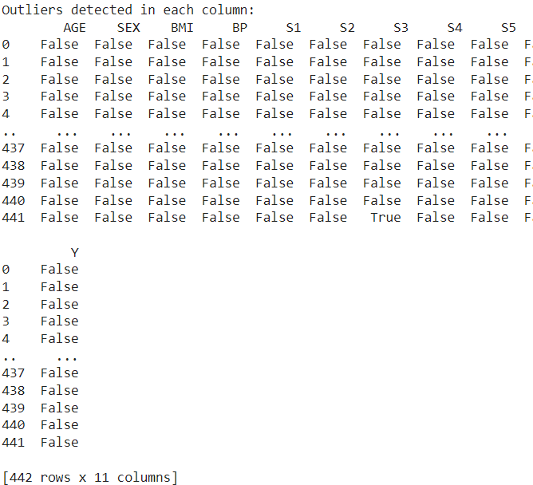

OUTLIERS

Slide 21
Data types after transformation: AGE int64 SEX int64 BMI float64 BP float64 S1 int64 S2 float64 S3 float64 S4 float64 S5 float64 S6 int64 Y int64 dtype: object Data Types: AGE int64 SEX int64 BMI float64 BP float64 S1 int64 S2 float64 S3 float64 S4 float64 S5 float64 S6 int64 Y int64 dtype: object

Slide 22


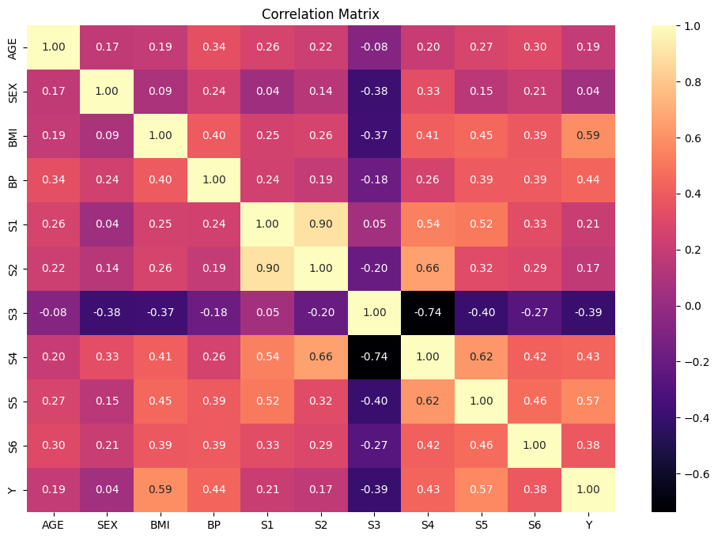
ThePhoto by PhotoAuthor is licensedCYYSA.

Slide 23
Feature Importance: Coefficient S5 67.108962 S4 10.159539 BMI 5.846363 BP 1.197093 S2 0.811152 S3 0.601653 S6 0.201599 AGE 0.137688 S1 -1.281685 SEX -23.064468

Slide 24

Limitations/Issues: - Potential outliers could skew the model's performance. - Limited context on the domain and interpretation of the features. - The dataset may not cover all relevant factors affecting the target variable.

Slide 25
THANK YOU

